Slide 1

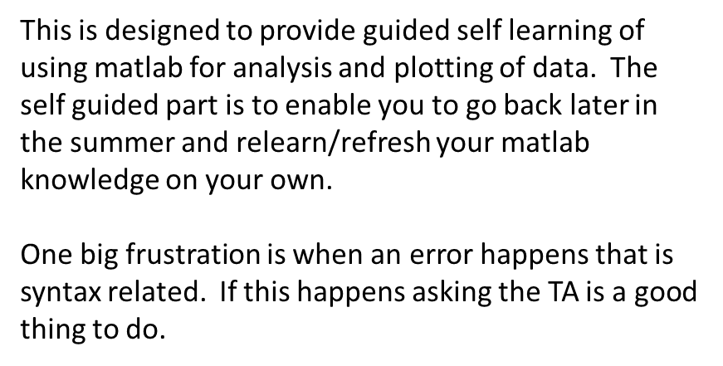
University of Illinois REU Introduction to MATLAB Day II
Compiled by Erik Huemiller

Slide 2
Goals for Today
Start with
Familiarity using the MATLAB interface
Make graphs with code and the GUI
Ability to import data from a csv file
End with
Ability to plot 2 graphs on the same plot in a variety of geometries
Be able fit the data to a predefined or custom function
Understanding of 3 Fit components and how to export them

Slide 3
Resources if you get stuck
MATLAB Documentation
Easiest to find through a Google search of “MATLAB + command”
There is example code with an explanation of most commands
Links to similar commands are listed at the bottom of the page
BYU Intro to MATLAB
Loosely used as an outline for this crash course
PDF with less explicit cross references than the online material
Weitzman Institute
PDF and PPT lectures with slides and example code
Slow moving course designed for people that have never coded before.
Email grad student mentor with questions
Slower response, but can give individual feedback
Can meet up in person to work through a tough problem
Easiest way to find answers about syntax problems or unknown errors

Slide 4
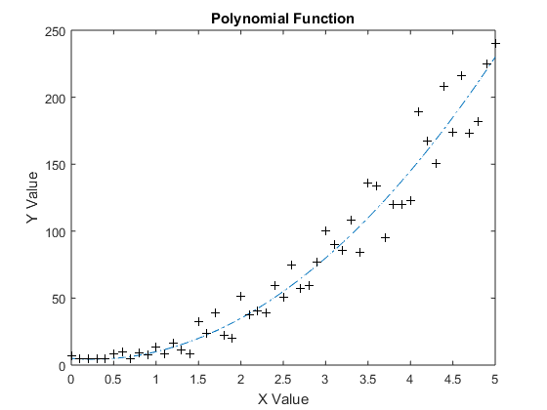
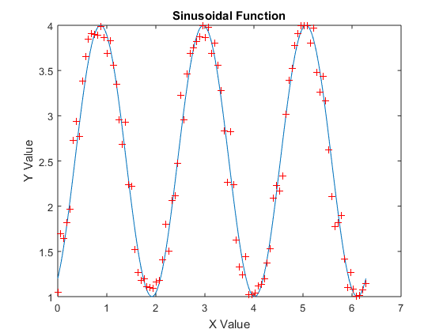
Creating some test Data
Before we get too far into plotting and fitting, we want to have some test data to play around with.
Try to write a program that will create some test data for us to fit functions to. Have 2 sets of data for each function, a low sample rate set with random noise and a high sample rate set to compare the noisy one to. Then plot both of the data sets for each function on the same graph to check that they in fact overlap.
Function Types
Polynomial Function
3 periods of a sine function.
You are encouraged to use the commands from yesterday (creating variables, vector manipulation, for loops) to create the data set.

Slide 5
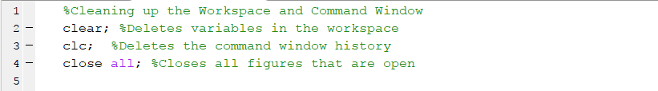
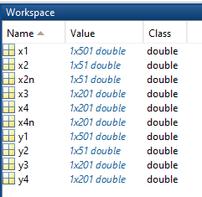
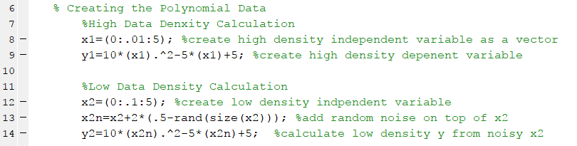
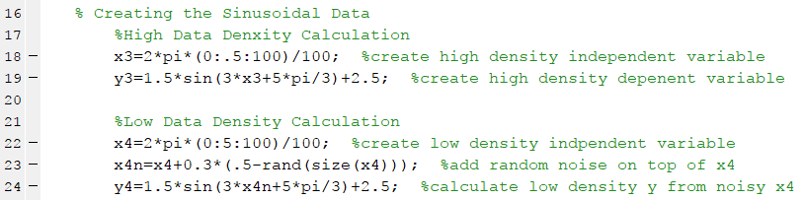
This is what mine looks like Generating Data for Manipulation

Slide 6
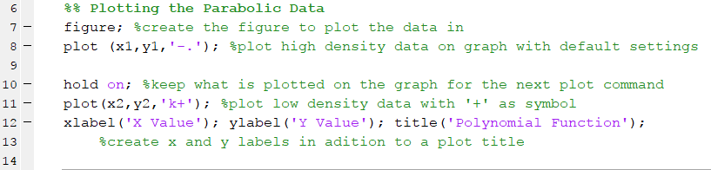
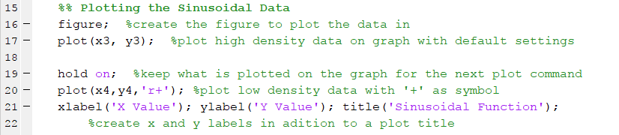
This is what mine looks like Plotting Data in a Figure

Slide 7
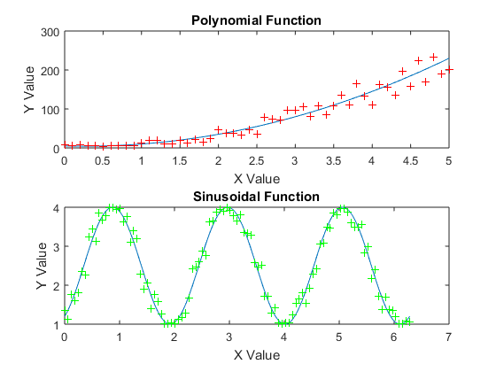
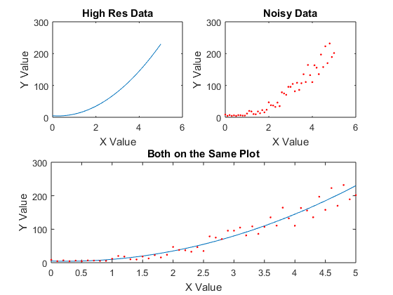
Sub Plots in Figures
In MATLAB you can make one figure with multiple plots on it using the subplot command.
There are 3 parts to the command
The Number of columns of graphs
The Number of Rows of graphs
The position you want the next plot command to access
Example Code
figure ;
subplot ( A , B , C ) ;
plot ( x1 , y1 , ’ . ’ ) ;
Try to replicate the figures on the right using the test data you generated earlier today and the subplot command. Don’t forget to add axis labels and titles for each of the graphs.

Slide 8
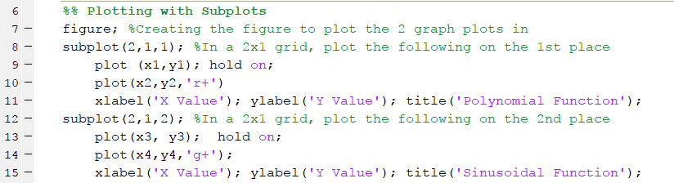
This is what mine looks like Utilizing Sub Plots to make Figures

Slide 9
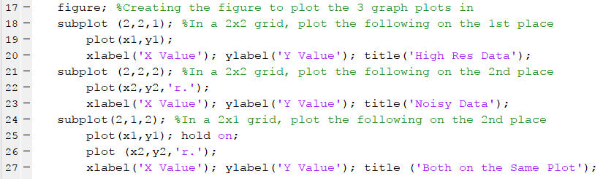
This is what mine looks like 3 Graphs with different geometries in a sub plot

Slide 10
Fitting data to a Function
Using Code
Many functional forms are available in MATLAB
Here is a list of them online
Simplest Example code:
The MATLAB command includes 3 pieces
The x data
The y data
The functional form of the fit
Some commonly used functional forms:
Polynomial – ‘poly#’ with # = 1 to 8
Sum of Sins – ‘sin#’ with # = 1 to 8
Gaussian – ‘gaussian#’ with # = 1 to 8
Exponential – ‘exp#’ with # = 1 to 2
Power Law – ‘power#’ with # = 1 to 2
Polynomial surface fit – ‘poly##’ with # = 1 to 8
The two numbers can be different values
Try setting up a fit to the test data you generated earlier today. Try to extract the coefficients using code. How do the coefficients compare to the values you used to create the data set?

Slide 11
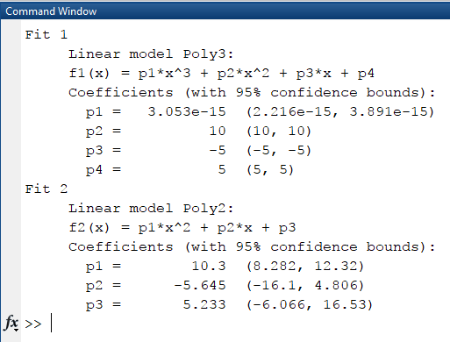
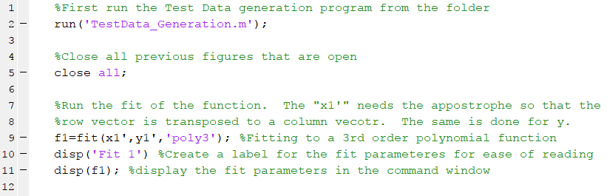
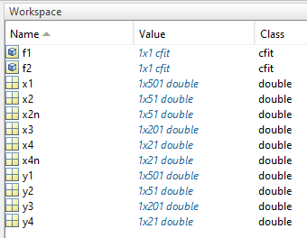
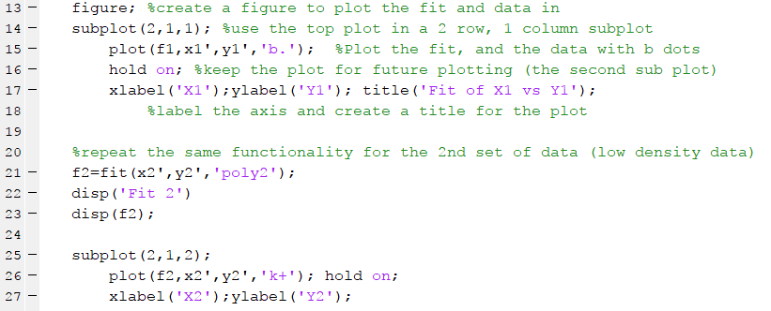
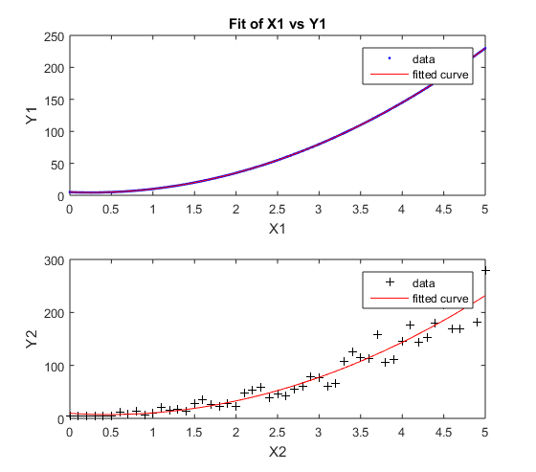
This is what mine looks like Fitting the Polynomial Test Data using Code
Creating Fit 1
Creating
Plot Fit 1
Analysis and
Plot for Fit 2

Slide 12
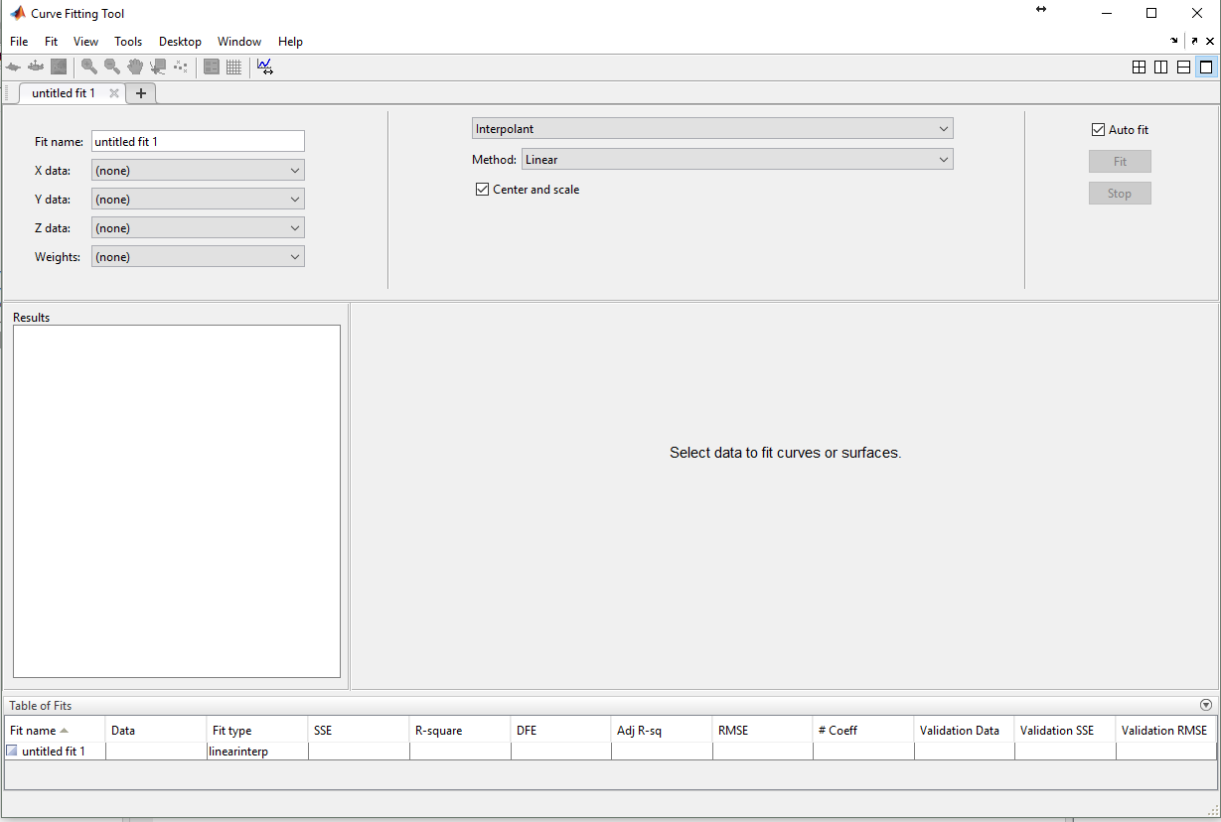
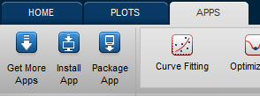
Fitting data to a Function
Fitting Functional Form
Using the GUI
Variables to fit
Open the Fitting App
Coefficients of Fit
Plot of Data and Fit
Try setting up a fit to the test data you generated earlier today. Try to extract the coefficients using the GUI and compare the values you used to create the data set?

Slide 13
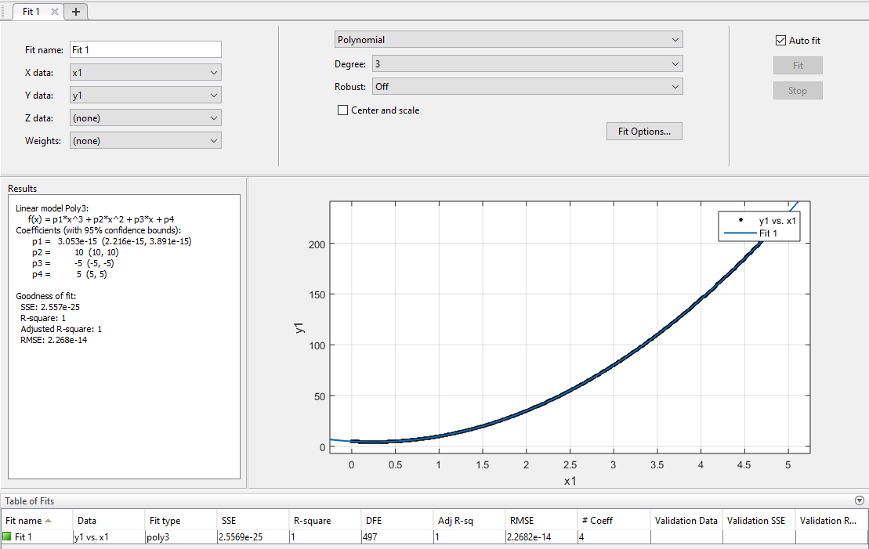
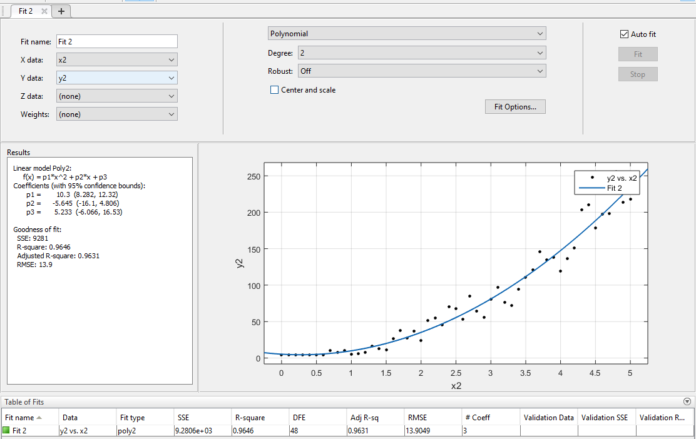
This is what mine looks like Fitting the Polynomial Test Data using the GUI

Slide 14
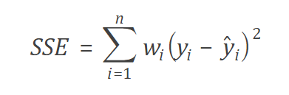
Analyzing the Fit
In the GUI, MATLAB provides parameters to
give information about the quality of the fits
Goodness of Fit Statistics
SSE = Sum of Squares Due to Error. A small number is better.
R-square = This statistic measures how successful the fit is in explaining the variation of the data. A value close to 1 signifies a better fit
Adjusted R-square = Same as above, but adjusted based on the number of fitting parameters (degrees of freedom) in the fit. A value close to 1 signifies a better fit
RMSE = Root Mean Squared Error. Just like the name suggests, a value close to 0 is better, but this value can be very large if there his high variance in your data.
Try fitting your low density data to the curves and see what the R squared and RMSE parameters are like. Then try adding more random noise to your data to see what effect that has on the same parameters.

Slide 15
This is what mine looks like Goodness of Fit Parameters on Parabola Test Data
Here are the goodness of fit parameters from my fits
No Noise in Data
With Noise in the Data

Slide 16
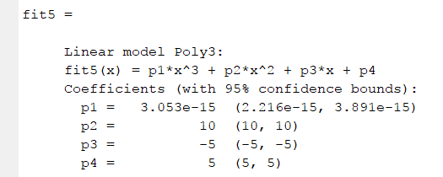
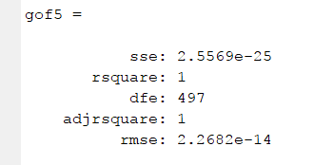
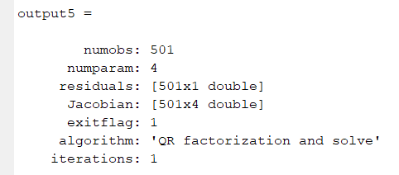
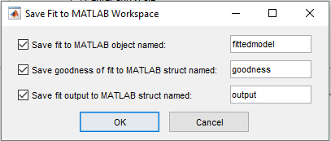
Saving a Fit in MATLAB
Example Code
When a fit is created there are three items created
The Fit data itself with the functional form and coefficients
The Goodness of Fit analysis
The Output quantifying the fit
Using Code: If you only include the first part of the output in your code, then the rest of the fit will not be added to your workspace
In the GUI: To export a fit you like in the App to the workspace, go to <fit -> save to workspace> and then a pop up window will show up giving you the option to name and save (or not) each of the items in the fit. The data you save will be in your workspace and accessible to manipulate with MATLAB functions and plotting.

Slide 17
Figuring out test functions
Download and import the test function data from the GitHub folder.
Try to figure out what functions the data were generated from. Extract the coefficients using either code or the GUI. Write you answers in the table below. Once you have determined the functional forms of the test functions, check your answers against your neighbor or in the SampleFuncGnerator.m file to see how you did.
Name | Fitting Functional Form | Number of Terms Needed to fit | R squared
Func1
Func2
Func3
Func4
Func5
Func6
Func7

Slide 18
Figuring out test functions
Download the test function data from the shared folder.
Try to figure out what functions the data were generated from. Extract the coefficients using either code or the GUI. Write you answers in the table below. Once you have determined the functional forms of the test functions, check your answers against your neighbor or in the SampleFuncGnerator.m file to see how you did.
 | Fitting Functional Form | # of Terms Needed to fit | R squared
Func1 | Polynomial | 1 | 1
Func2 | Exponential | 1 | 1
Func3 | Polynomial | 3 | 1
Func4 | Sum of sines | 2 | 1
Func5 | Gaussian | 2 | 1
Func6 | Fourier Series | 3 | 1
Func7 | Exponential | 2 | 1

Slide 19
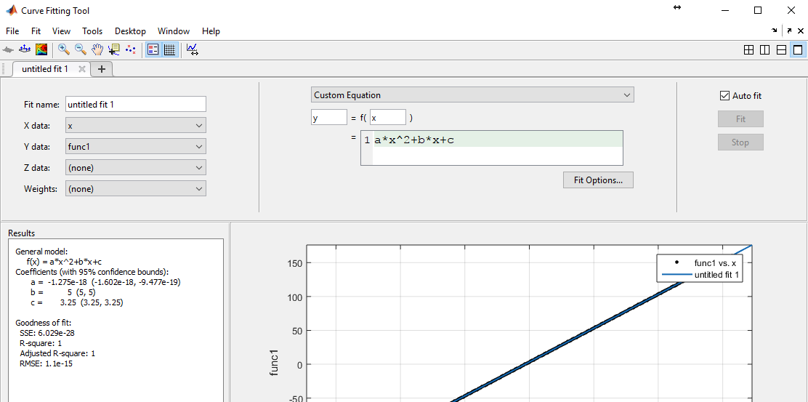
Fitting to Custom Functions
MATLAB has the ability to fit the data to an arbitrary function that is user defined. This is easiest to do in the GUI setup by selecting the “Custom Equation” functional form, and then typing the equation in the following line. It can be a function of multiple variables if that is what you are trying to fit.
Functional Form
Try typing in the functional form of func3 and getting the curve fitting tool to output the correct coefficients for each of the terms.
Definition of Equation

Slide 20
Time to Play with MATLAB
The remaining time is open ended where you can use the skills you have learned working with MATLAB to do a project of your choosing. Here are a few suggestions.
Try using MATLAB to provide some insight into the results from the Boston Marathon.
Can you write a program that extracts the number of people in each bin of a histogram, and then fit them to multiple Gaussians
What is the functional form of the finishing results
Boston Marathon Data
Try to find the public results from a different scientific experiment with public data, and use MATLAB's fitting parameters to fit their data and run analysis on it
Other Scientific Data

